Slide 1


Flight Fare Prediction: A Comprehensive Study
Flight ticket prices are often seen as unpredictable, fluctuating significantly within short time spans. However, using data science techniques, we aim to demonstrate that given the right data, these prices can indeed be predicted. This report analyzes flight ticket prices for various airlines between March and June 2019, covering multiple routes and factors influencing prices.

Slide 2
Dataset Overview
The dataset used for this analysis comprises 10,683 records for training and 2,671 records for testing. It includes features such as Airline, Date_of_Journey, Source, Destination, Route, Dep_Time, Arrival_Time, Duration, Total_Stops, and Additional_Info. The target variable is Price, representing the ticket price.
Training Set
10683
Test Set
2671

Slide 3

Data Preprocessing
The initial step involved data loading using pandas. Subsequently, data cleaning and feature engineering were performed. Date and time features were extracted and converted into separate columns, such as Day, Month, Year, Dep_hour, Dep_min, Arrival_hour, and Arrival_min. Duration was parsed to extract hours and minutes.
1
2
3
Data Loading
Data Cleaning
Feature Engineering
The dataset was loaded using pandas.
Duplicates were removed and missing values were handled.
New features were created from existing columns, such as Day, Month, Year, Dep_hour, Dep_min, Arrival_hour, Arrival_min, and Duration.

Slide 4
Categorical Feature Handling
Categorical features like Airline, Source, and Destination were converted into numerical variables using one-hot encoding. This process creates separate binary columns for each unique category, representing the presence or absence of that category for a particular flight.
Airline
Source
Destination
Jet Airways, IndiGo, Air India, SpiceJet, Vistara, GoAir, Multiple carriers, Air Asia, Trujet
Delhi, Kolkata, Bangalore, Mumbai, Chennai
Cochin, Banglore, Delhi, New Delhi, Hyderabad, Kolkata, Mumbai

Slide 5
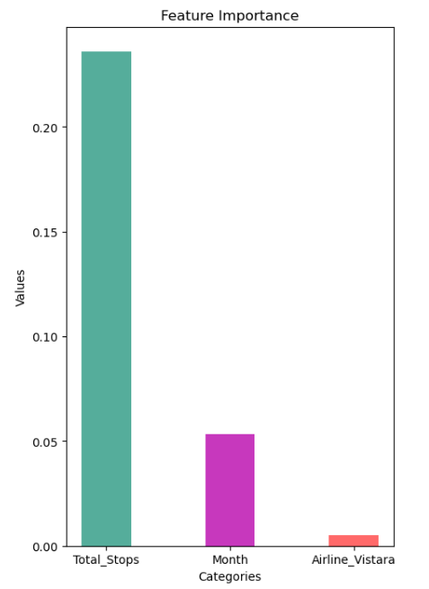
Feature Importance
Feature importance analysis revealed that Total_Stops was the most significant feature, followed by Day and Airline_Jet_Airways. This indicates that the number of stops, the day of the journey, and the specific airline have a strong influence on flight ticket prices.
1
Total_Stops
2
Day
The number of stops during the flight is a major factor influencing price.
The day of the journey also plays a significant role in determining ticket prices.
3
Airline_Jet_Airways
The specific airline, in this case, Jet Airways, is a key factor in price variation.

Slide 6
Model Building and Evaluation
Several regression models were tested and evaluated based on their performance metrics.
Model
MAE
MSE
RMSE
R2 Score
Linear Regression
1998.639306
8.68E+06
2945.796236
0.583808
Polynomial Regression
1682.40661
6.09E+06
2468.386729
0.707777
Ridge Regression
1999.825146
8.67E+06
2944.926607
0.584054
Decision Tree Regression
1405.1077
5.97E+06
2442.734247
0.713819
Gradient Boosting Regression
1537.088597
5.15E+06
2268.34933
0.753221
XGBoost Regression
1132.428776
3.39E+06
1841.272342
0.837399
Random Forest Regression
1171.100148
3.86E+06
1965.544611
0.814709

Slide 7



Model Performance Comparison
Among the tested models, XGBoost Regression emerged as the best performer, achieving the lowest MAE, MSE, and RMSE values, along with the highest R2 score. This indicates that XGBoost Regression provides the most accurate predictions for flight ticket prices based on the given features.
Linear Regression
Decision Tree Regression
XGBoost Regression
MAE: 1998.639306,
MSE: 8.68E+06,
RMSE: 2945.796236,
R2 Score: 0.583808
MAE: 1405.1077,
MSE: 5.97E+06,
RMSE: 2442.734247,
R2 Score: 0.713819
MAE: 1132.428776,
MSE: 3.39E+06,
RMSE: 1841.272342,
R2 Score: 0.837399

Slide 8
Key Findings and Insights
The analysis revealed that Duration and Total_Stops are significant predictors of flight prices. Categorical variables like Airline, Source, and Destination also contribute substantially to price variation. The XGBoost Regression model demonstrated the best performance, making it a suitable choice for predicting flight prices based on the given features.
Duration
Total_Stops
Longer flight durations tend to have higher prices.
Flights with more stops generally have higher prices.
Airline
Source and Destination
Different airlines have varying price structures.
Flights originating from or destined for major cities often have higher prices.

Slide 9



Conclusion and Future Work
The analysis demonstrates that flight ticket prices can be effectively predicted using machine learning models. The XGBoost Regression model outperformed other models, showcasing its ability to accurately predict flight prices based on the given features.
Incorporate Seasonality
Explore Deep Learning
Real-time Prediction
Consider seasonal variations in demand and prices.
Investigate the potential of deep learning models for improved performance.
Develop a system for real-time price prediction.

Slide 10

Future Research Directions
Future research could explore the impact of external factors on flight frequencies, such as holidays and weather conditions. Additionally, analyzing delays and their causes could provide valuable insights into flight operations and pricing strategies.
1
External Factors
2
Delay Analysis
Investigate how holidays and weather affect flight frequencies and prices.
Analyze delays and their causes to understand their impact on flight operations and pricing.

